Slide 1

Names and stuff

Slide 2
Motivation

Slide 3
DATA

Slide 4
Algorithms
Just write the name of three algorithms in this slide

Slide 5
STEPS BEFORE IMPLEMENTING ALGORITHM
Cleaning Data
Data Conversion
Training Data using Algorithm

Slide 6
Cleaning Data

Slide 7
Data Conversion

Slide 8
Multinomial Naïve Bayes

Slide 9
Bernoulli Naïve Bayes

Slide 10
Logistic Regression

Slide 11
OUR NEW ALGORITHM
We have used sentimental analysis and decision trees on the major attributes: TRAINING ACCURACY : 80.1%
REASONS FOR CHOOSING AN ALGORITHM: 1. Need to scrub/clean the bot data (Due to inaccurate labelling) 2. Identify the user accounts.
CONSIDERATION FOR ALGORITHM! 1. Attributes of a twitter account like (screen name, name, description, statuses count, followers count, friends count) 2. The best data set are our personal user and bot data set and crowdsourced user data.

Slide 12
FIRST STEP
Screen Names
‘BOT’
Name
Description
CHANGES MADE: VALUE CHANGED TO 2
DRAWBACK: A legitimate user may have a phrase like ‘bottle’, ‘botany’
MEASURE: We have avoided this false positive in the future steps

Slide 13
CONCLUSIONS FROM FIRST STEP (USER DATA)
PERSONAL USER DATA SET
TRAINING USER DATA SET
Accuracy of finding bot word: 0%
Accuracy of finding bot word: 1.5%

Slide 14
CONCLUSIONS FROM FIRST STEP (BOT DATA)
PERSONAL BOT DATA SET
TRAINING USER DATA SET
29 of 50 accounts discovered
388 of 1323 accounts discovered
Accuracy of finding bot word: 58%
Accuracy of finding bot word: 29.33%

Slide 15
SECOND STEP
0 statuses
BEGINNER USER ACCOUNT
0 followers
0 friends
PERSONAL USER DATA SET ACCURACY: 0%
PERSONAL BOT DATA SET ACCURACY: 4% (2)
TRAINING USER DATA SET ACCURACY: 1.626% (24)
TRAINING BOT DATA SET ACCURACY: 19% (250)

Slide 16
THIRD STEP
TWEETS TO FRIENDS RATIO < 12
TWEETS TO FOLLOWERS RATIO <12
Recognizing the common users

Slide 17
CONCLUSIONS FROM THIRD STEP (PERSONAL USER DATA)
ACCURACY: 100%

Slide 18
CONCLUSIONS FROM THIRD STEP (PERSONAL BOT DATA)
ACCURACY: 2%

Slide 19
CONCLUSIONS FROM THIRD STEP (TRAINING USER DATA)
ACCURACY: 89.7%

Slide 20
CONCLUSIONS FROM THIRD STEP (TRAINING BOT DATA)
ACCURACY: 16.7%

Slide 21
FOURTH STEP
VERIFIED
YES
NO
USERS
BOTS

Slide 22
CONCLUSIONS FROM FOURTH STEP (USER DATA)
ACCURACY: 52%
ACCURACY: 43.7%

Slide 23
CONCLUSIONS FROM FOURTH STEP (BOT DATA)
ACCURACY: 0%
ACCURACY: 0.6%

Slide 24
FIFTH STEP (CLEVER BOTS)
NO ’BOT’ IN SCREEN NAME, NAME & DESCRIPTION
TWEETS TO FRIENDS RATIO >10
TWEETS TO FOLLOWERS RATIO >10
Recognizing the clever bots

Slide 25
ACCURACY CALCULATION
USER DETECTION
OUR USER DATA SET ACCURACY: 100%
TRAINING USER DATA SET ACCURACY: 98.3%
BOT DETECTION
OUR BOT DATA SET ACCURACY: 90%
TRAINING BOT DATA SET ACCURACY: 65%

Slide 26
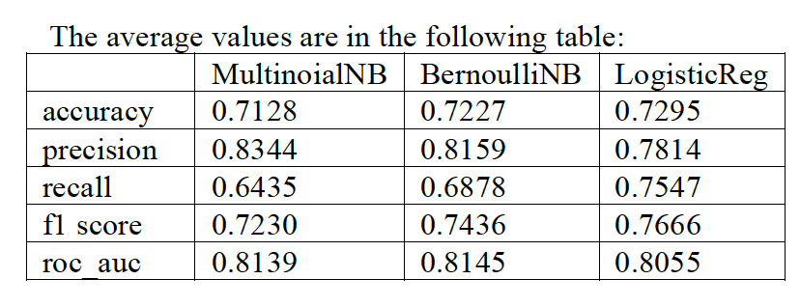
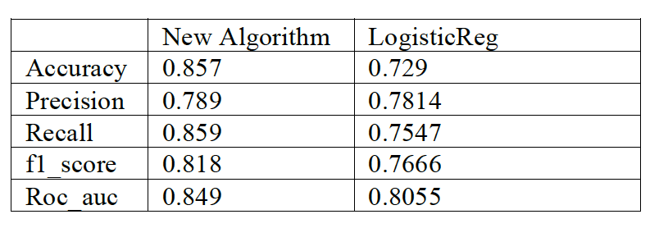
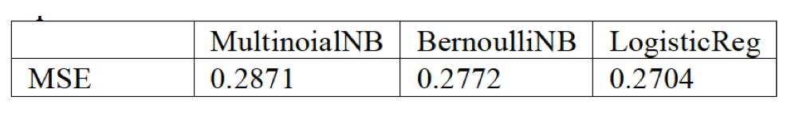
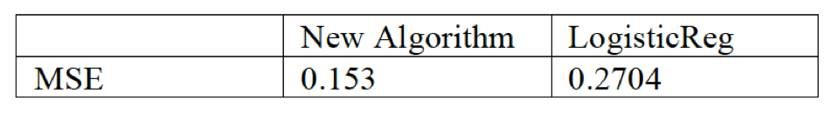
PERFORMANCE ANALYSIS

Slide 27
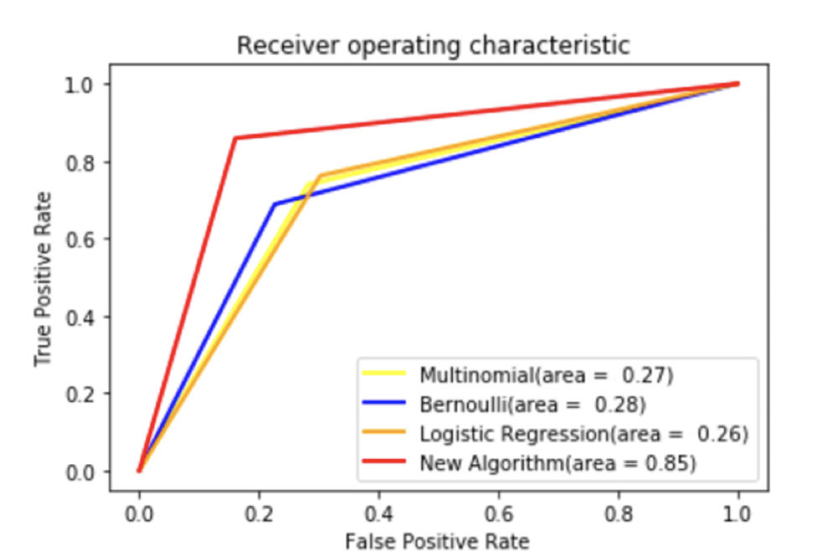
RECEIVER OPERATING CHARACTERISITCS

Slide 28
FUTURE WORK
Sentimental Analysis
Friends Hierarchy
User metadata
Behavior Features

Slide 29
THANK YOU

